Slide 1
An FPGA-Based Open Platform for Ultrasound Biomicroscopy.
W. Qiu, Y. Yu, F. K. Tsang and L. Sun, "An FPGA-based open platform for ultrasound biomicroscopy," in IEEE Transactions on Ultrasonics, Ferroelectrics, and Frequency Control, vol. 59, no. 7, pp. 1432-1442, July 2012.
Anusha Swarup, ECE Graduate Student & Medini J. Aradhya, ECE Graduate Student.
1/48

Slide 2
Published in IEEE Transactions on Ultrasonics, Ferroelectrics, and Frequency Control. ( Volume: 59 , Issue: 7 , July 2012 )
Authors from Department of Health Technology and Informatics, The Hong Kong Polytechnic University, Hong Kong SAR, China
2/48

Slide 3
Introduction to what is discussed :
Application : Use of Ultrasound Biomicroscopy (UBM) for preclinical studies in small animal models.
Need for reconfigurable platform to accommodate the requirements of each study.
This paper presents the development of an open UBM platform based on an FPGA ( Field Programmable Gate Array) that is embedded on a PCB to achieve a) B-Mode Imaging b) Pulse Wave Doppler.
Most functions are achieved by the reprogrammable FPGA.
Structure of the all inclusive PCB.
3/48
Notes:
2) UBM system must accommodate different transducer characteristics, data acquisition strategies and signal processing/ reconstruction models.

Slide 4
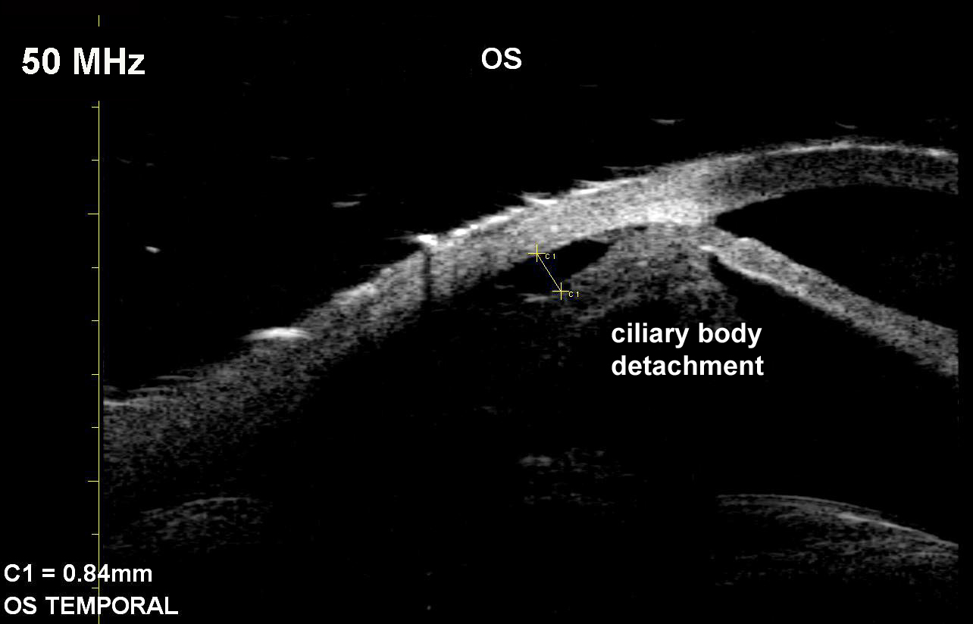
Motivation
High-resolution, noninvasive visualization of living tissues is an indispensable technique for observing physiological activity on a miniature scale.
Diseases associated with small human structures such as eyes, skin, and blood vessels can benefit from this technique.
To understand physiological and functional mechanisms for pathogens and treatment strategies.
4/48
Notes:
There are other Medical Imaging Techniques like
MRI – Magnetic Resonance Imaging
CT – Computed Tomography
PET – Positron Emission Tomography. Etc
But UBM in this implementation is : A) Fast B) Reconfigurable C) able to delineate small structures with final Spatial Resolution.
Used for Ophthalmology, Dermatology, malignant tumor diagnosis, cardiac diseases ( non invasive diagnosis ) and Embryonic developmental biology.

Slide 5
Need for an open platform
UBM systems with fixed specifications such as : 1) Transducer Characteristics 2) Data acquisition strategy 3) Signal Processing Methods 4) Image Display Approach Do not satisfy pre clinical broad pre clinical trial requirements.
Researchers need a highly flexible device to best suit their specific investigations.
Access to the raw experimental data is also important for analysis.
Current Platform allows users to customize the system for a specific biomedical study
5/48
Notes:
All these requirements make it hard to implement on a hardware scale PER use case. So we bring in an FPGA based platform that has most of these functions done digitally on board and also had a memory element to buffer the data to make it accessible later on if need be.

Slide 6
Single Element Transducer based UBM
6/48

Slide 7
A single-element transducer is translated by a motor probe to acquire a cross-sectional image.
A pulse generator is employed to produce a HV pulse to excite the transducer to generate ultrasonic waves.
A transmit and receive (T/R) switch controls the transmission of ultrasonic waves and the reception of the echo signal backscattered from the tissue.
The imaging platform includes an amplifier to boost the weak echo signal, a band-pass filter (BPF) to remove noise, analog-to-digital converter (ADC) to digitize the amplified signal, and a computer to process the digital signal and display the ultrasound images
7/48

Slide 8
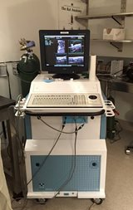
Drawbacks
There are commercially available UBM systems that follow this architecture Eg: Vevo 770, Visual-Sonics Inc.
Such a system uses module-based components a) Commercial ADC for signal digitization, b) Computer for data processing and image display.
Though module based architecture ensures fast processing it is rigid in terms of circuitry and needs post processing for visualization.
Also RF data transmission and processing needs fast data transfer and powerful calculation capabilities.
For this reason, the frame rate is limited. Even though GPU was used in a few UBMS.
8/48
Notes:
Something that’s also of importance is the TYPE OF TRANSDUCER USED.

Slide 9
Types of Transducers
There are two transducers discussed in this paper. Namely a) Single Element Transducer b) High Frequency Array Transducer.
High freq. Array transducers can achieve electronic dynamic focusing to increase the depth of the field ( Eg: Vevo 2100) This prevents the use of mechanical scanning, which allows for better imaging speed.
But the design and fabrication of high frequency array transducers and electronic systems are highly complex, challenging, and costly.
To a large extent, single-element transducer-based systems provide a viable and cost-effective solution
9/48

Slide 10
The Open(FPGA Based) UBM Platform.
An FPGA serves as the core processor and replaces hardware circuitry
Both B-mode imaging and directional pulsed-wave (PW) Doppler can be realized on this platform.
A high-frequency digital quadrature demodulation algorithm using the Hilbert transform was implemented to achieve fast and accurate PW Doppler profiling.
A coordinated rotation digital computer (Cordic) algorithm was employed for envelope detection together with Hilbert transform.
10/48

Slide 11
low-noise, high-speed analog electronics were used for high SNR and high sensitivity.
A 64-bit PCI bus was used for high-speed data transmission interface for image data/ Raw RF data transfer to a computer through direct memory access operation.
All components were incorporated onto a single printed circuit board (PCB) for compactness and cost-effectiveness
11/48

Slide 12
Schematic for Open UBM
12/48
Notes:
Oscillator generates periodic signals a phase detector compares the phase of that signal to to that of I/P periodic signal (V)
Adjusting such that same phase is maintained.
Output signal phase is related to input signal phase.

Slide 13
The algorithms implemented in the FPGA can easily be adjusted through GUI software for different application requirements. (BPF , ADC DSC etc.)
The user can also choose different imaging strategies and reprogram the (B-Mode & PW-Doppler)
An external RAM with large capacity and high-speed interface is configured to the FPGA to support programmable applications
A 64-bit high-speed PCI interface is employed for real-time imaging and fast RF
13/48
Notes:
Some Features

Slide 14
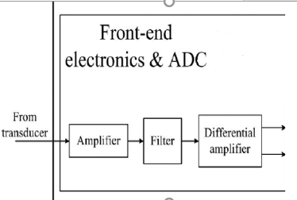
Front End Electronics
Quality of the UBM significantly affected by Front end electronics.
Poor electronic hardware could mean more noise which can corrupt the images
Also, UBM has a weak echo signal so distortion in the front end would mean that the image cannot be reconstructed.
Components used : a) Low noise Amplifier ( SMA 231 Tyco Electronics) b) Low pass filter ( RLP83+, Minicircuits) Cut off Freq. 93MHz. c) Low noise Distortion Amp. (THS 4509 – 2nd stage Amp +20dB Gain) ( also used to convert Single ended signal to differential pair.)
14/48
Notes:
a) Max gain flatness +- 0.2 dB, Max noise was 1.7 dB, range 10-480 MHz.

Slide 15
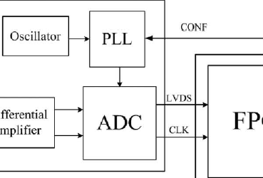
ADC
Sampling freq >= 2 * Max Freq. of Echo. (Nyquist Theorem)
Components Used : A) Single ADC ( ADS 5517, TI ) Fs = 200MHz. B) Clock generator (CDCM61002, Texas Instruments Inc.)
After digitization, the digital signal is transferred to the FPGA through a low-voltage differential signaling (LVDS) bus.
An integrated voltage-controlled oscillator and a low-jitter clock generator provided an accurate clock source for high-precision data acquisition.
15/48
Notes:
PLL

Slide 16
FPGA
FPGA Used: Stratix II EP2S60F672I4, Altera Corp.
The FPGA has 60 440 equivalent logic elements and 493 user I/O pins. It includes 36 DSP blocks
A 64-MB RAM combined with two DDR2 SDRAMs (MT47H16M16, Micron Technology) is used for temporary buffering of data.
The image data or raw RF data are transferred to a computer through a 66-MHz 64-bit PCI bus for storage or post-processing.
FPGA can be reprogrammed without any hardware circuit changes
16/48
Notes:
DSC – Digital Scn Converter

Slide 17
Schematic of Algorithms implemented on FPGA.
17/48
Notes:
Data pre conditioninf BPF
1) TGC – Time Gain Compensation ( Amplify with configurable Coeff. To compensate for Ultrasound attenuation caused due to tissues. 2) Envelope detector ( measures Amplitude of the echo from the echo + carrier signal )
3) Then DSC Digital scan converter. Logarithmic compression.
PW Doppler Effect. BPF – Differential configuration for Flow measurement. Flow information from Echo signal data saved in dual port RAM. For doppler gate selection. ( after a train of data is accumulated ) then Spectrum Extraction to get flow velocity.

Slide 18
Flexible Digital Scan Conversion
Image reconstruction depends on the transducer scanning mechanism. Eg: when the transducer is translated in a rotation scan, the ultrasound signal is acquired at different angles in polar coordinates. But the ultrasound image, is displayed in Cartesian coordinates on the monitor.
Therefore, scan conversion from polar to Cartesian coordinates is needed for accurate visualization.
A high-speed DSC with linear interpolation is needed.
However, DSC for large images requires enormous RAM which is limited in the FPGA.
Therefore method based on high-speed DDR2 SDRAM is proposed in this paper
18/48

Slide 19
Flexible Digital Scan Conversion
19/48

Slide 20
Digital Quadrature Demodulation
PW Doppler Circuits generally involve a lot of components on the hardware level that causes introduction of noise into the system, which affects the quality of the image being processed.
Complete digital implementation of PW Doppler has many advantages, such as low noise, stability, flexibility, and small size.
Here, Hilbert transform is used for precise I/Q acquisition.
Two separate RAMs are employed to buffer the I/Q data for Doppler gate selection.
One data point is chosen corresponding to the depth at which the Doppler signal is interrogated.
Afterward, a train of such data points is collected and transferred to the spectrum extraction module for flow velocity estimation
20/48

Slide 21
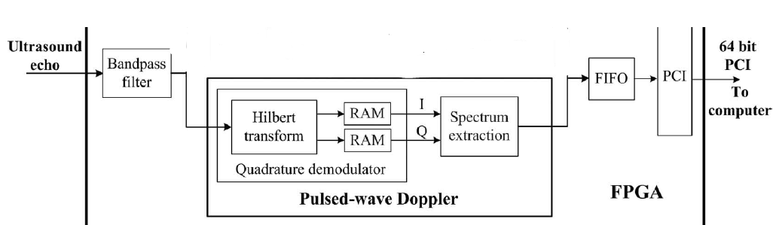
Spectrum Extraction
Spectral analysis is conducted to estimate the flow velocity and the blood flow pattern
Fourier Transform is employed to perform Spectral Analysis (CFFT) (Get the frequency spectrum of windowed data )
Afterward, the results are transferred to the computer through the PCI interface for display and storage.
21/48
Notes:
Complex FFT 486 point
More Data points used more is the resolution but, it also slows down the frame rate…… Number of data points can be adjusted by the GUI

Slide 22
Evaluation and Results
A. Performance of Front-End Electronics The spectrum analyzer was used to receive and analyze the amplified signal in different frequencies sent by the signal generator and processed by the front-end electronics
Fig shows the system gain as a function of frequency. The front-end electronics shows a good flatness of gain
with fluctuations smaller than +-1.2 dB in the range from 10 to 90 MHz.
22/48

Slide 23
Evaluation and Results
B. Performance of BPF The performance of the digital BPF was tested by sending twenty cycles of a 50-μV sinusoidal signals using a function generator.
The unprocessed raw RF data and the data processed by the BPF were transferred to the PC. It can be seen that the SNR after the BPF is significantly improved.
23/48

Slide 24
Evaluation and Results
C. Testing of Imaging Speed
To evaluate the image processing and data transfer speed of the platform, a burst of 50-MHz sinusoidal signal with high pulse repetition frequency was generated and sent to the platform.
A frame counter in the FPGA calculated the speed of the platformin terms of the number of processed images per second.
The test result showed that the platform could process more than 500 images (486 × 486 pixels) per second.
24/48

Slide 25
Evaluation and Results
D. Pulse Wave Doppler
The cyclic pattern of the spectrogram correlated well to the heartbeat of the subject. The heart rate of 80 beats/ min measured from the spectrogram agreed with the heart rate of 78 beats/min of the subject.

Slide 26
Low Complex, Programmable FPGA based 8-Channel Ultrasound Transmitter for Medical Imaging Researchers
C. Dusa, P. Rajalakshmi, S. Puli, U. B. Desai and S. N. Merchant, "Low complex, programmable FPGA based 8-channel ultrasound transmitter for medical imaging researches," 2014 IEEE 16th International Conference on e-Health Networking, Applications and Services (Healthcom), Natal, 2014, pp. 252-256.
26/48

Slide 27
Researchers from the Indian Institute of Technology, Bombay
IEEE 16th International Conference on e-Health Networking, Applications and Services
27/48

Slide 28
Introduction
Ultrasounds are sound waves with frequencies higher than the upper audible limit of human hearing.
Not different from "normal" sound in its physical properties
Frequency - 20 kHz up to several gigahertz.
Applications: Detect objects and measure distances.
28/48

Slide 29
Ultrasound in Medicine
Ultrasound systems can generate images of internal organs and structures, map blood flow and tissue motion, and provide highly accurate blood velocity information
It is radiation-free, patient-friendly and less expensive
The adoption of this modality by all categories of hospitals and other health care institutions has given rise to new designs and market opportunities
29/48

Slide 30
Ultrasound Imaging Systems
Basic Principle:
Transmit ultrasound burst signal into the area of interest
receive echoes
process for imaging
Using a Digital Transmit (Tx) Beamformer Module
“Closed” architecture provides researchers with limited access to the ultrasound transmit module
30/48

Slide 31
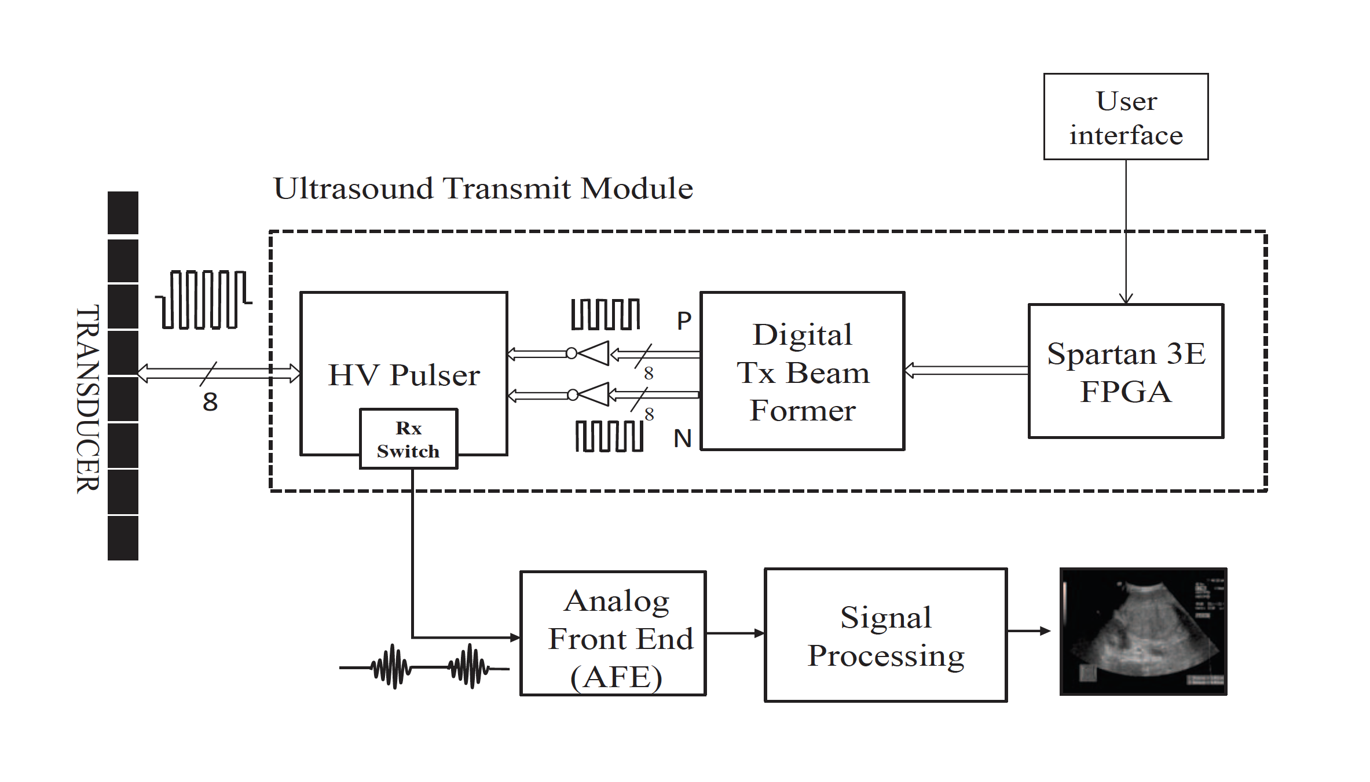
Ultrasound System
The system architecture consists of:
Transducer array,
High Voltage (HV) pulsar
Digital Tx Beamformer,
FPGA device
User Interface,
Analog Front End (AFE)
Signal Processing Modules
31/48

Slide 32
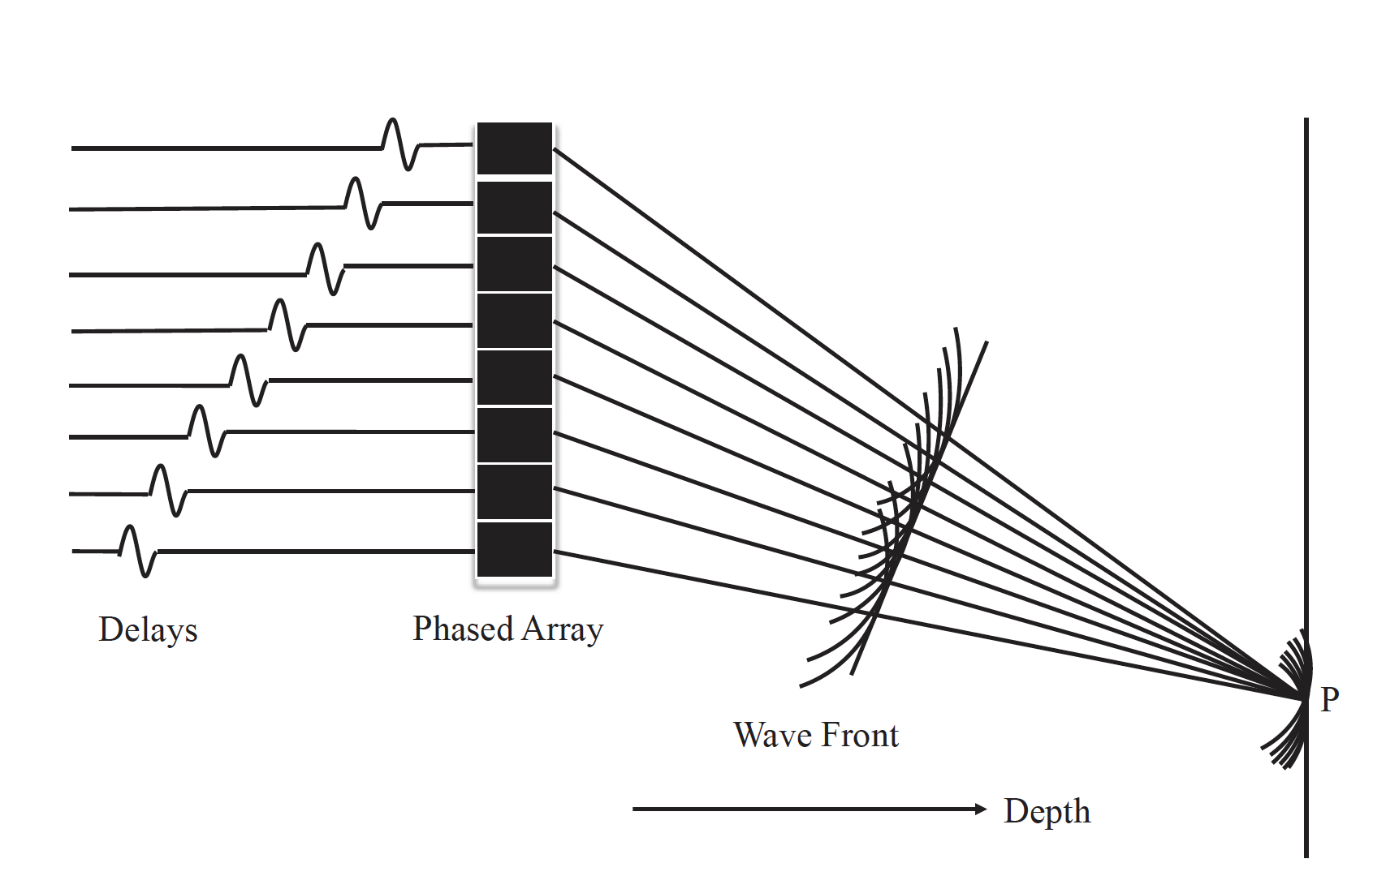
Transducer Array
The ultrasonic transducer array includes multi-layer transducer elements as transmit and receive elements
Transducers are excited in two modes:
Linear Array Mode : subset of transducer
elements are excited
Phased Array Mode : all the elements are
excited to focus the sharp ultrasound beam
at focal point
The time delays are applied to create constructive interference of wave fronts at different focal points.
32/48

Slide 33
33/48

Slide 34
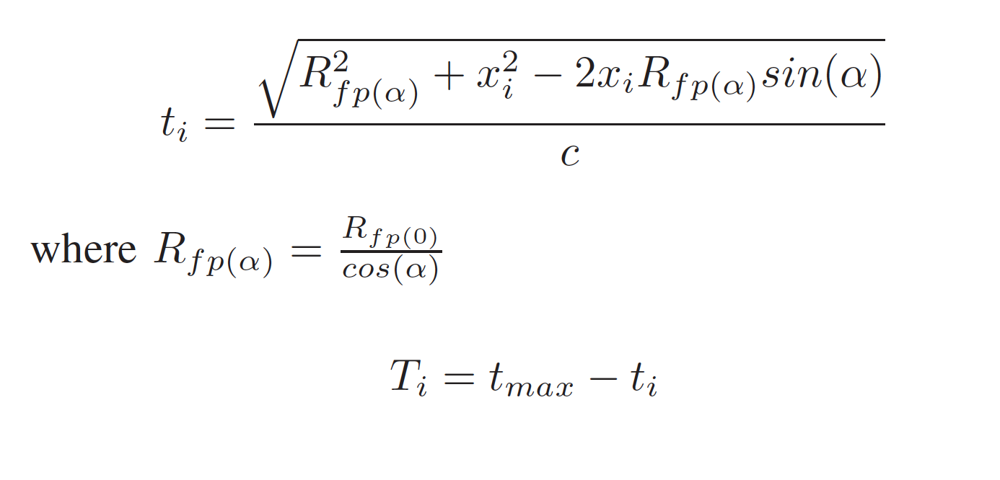
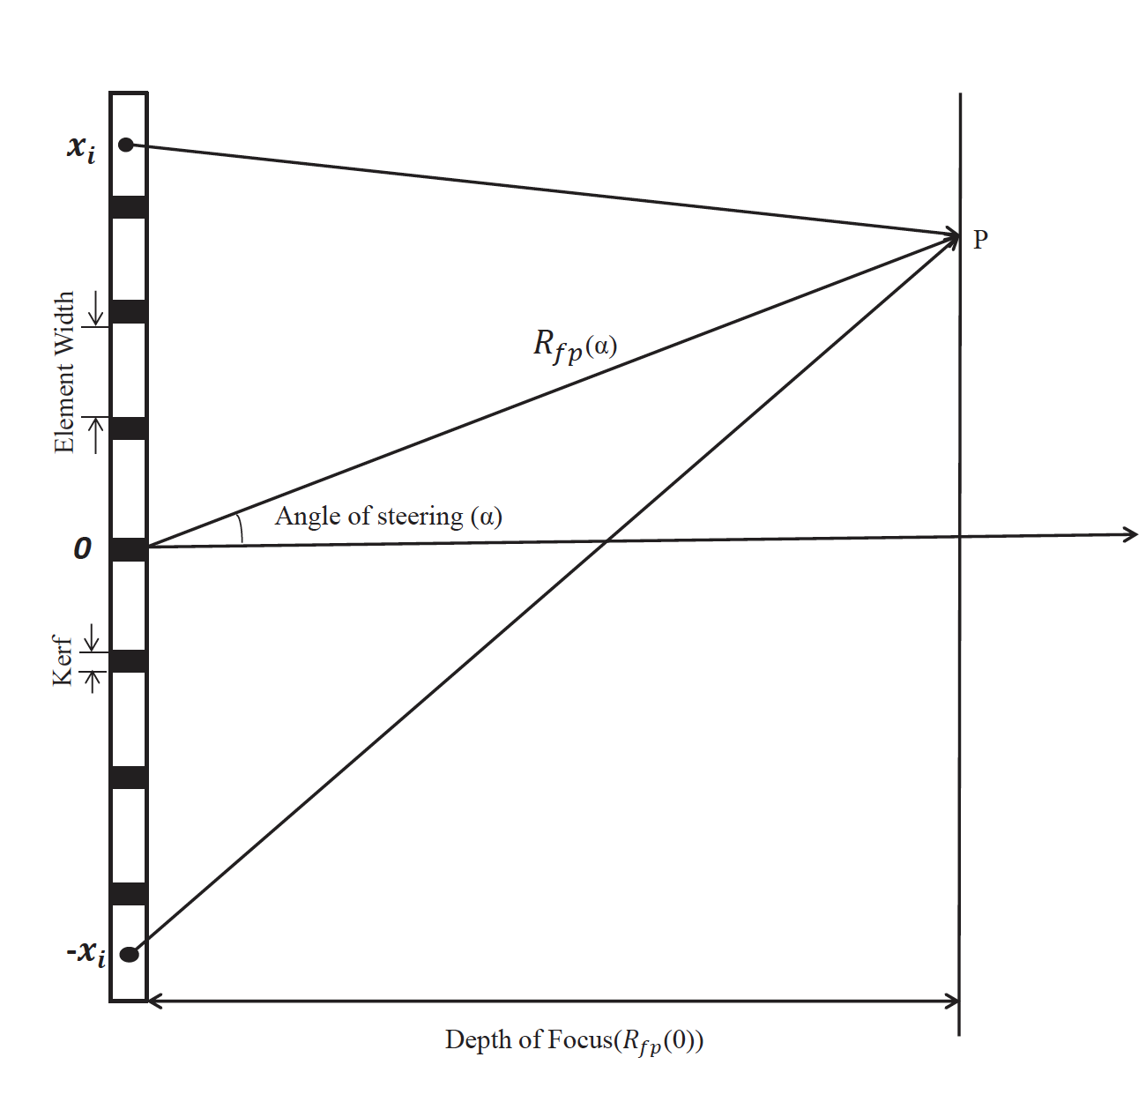
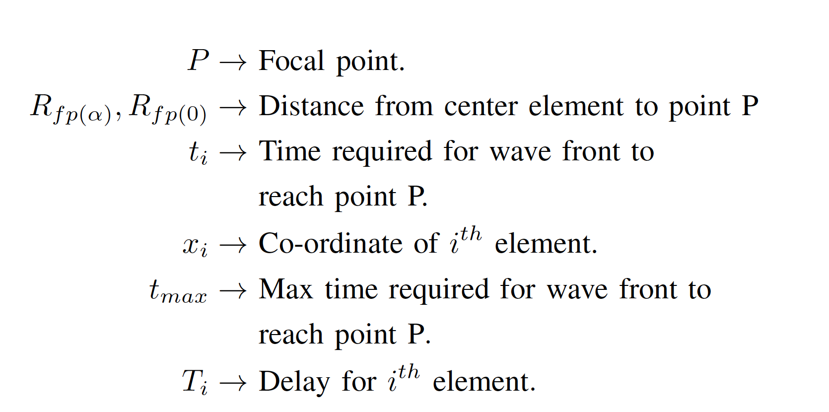
34/48

Slide 35
FPGA Based Acoustic Beam Steering
Spartan-3E FPGA starter kit is used to control the direction of acoustic beam and depth of focus
To steer and focus the beam, each transducer element is delayed and excited by Ti
A fast update of the delay profile per each scanline is achieved using a single high speed Serial Peripheral Interface (SPI) between the FPGA and the Tx beamformer
Pre-calculated delay profile per scanline are stored in FPGA register block memory to reduce the computational burden
35/48

Slide 36
Digital Tx Beamformer
A 8-channel programmable beamformer is used to generate proper phased logic pulses by programming with FPGA
To improve resolution of the ultrasound image
The beamformer has internal programmable registers, which can be programmed to configure transmission parameters at a maximum data rate of 80 Mbps
36/48

Slide 37
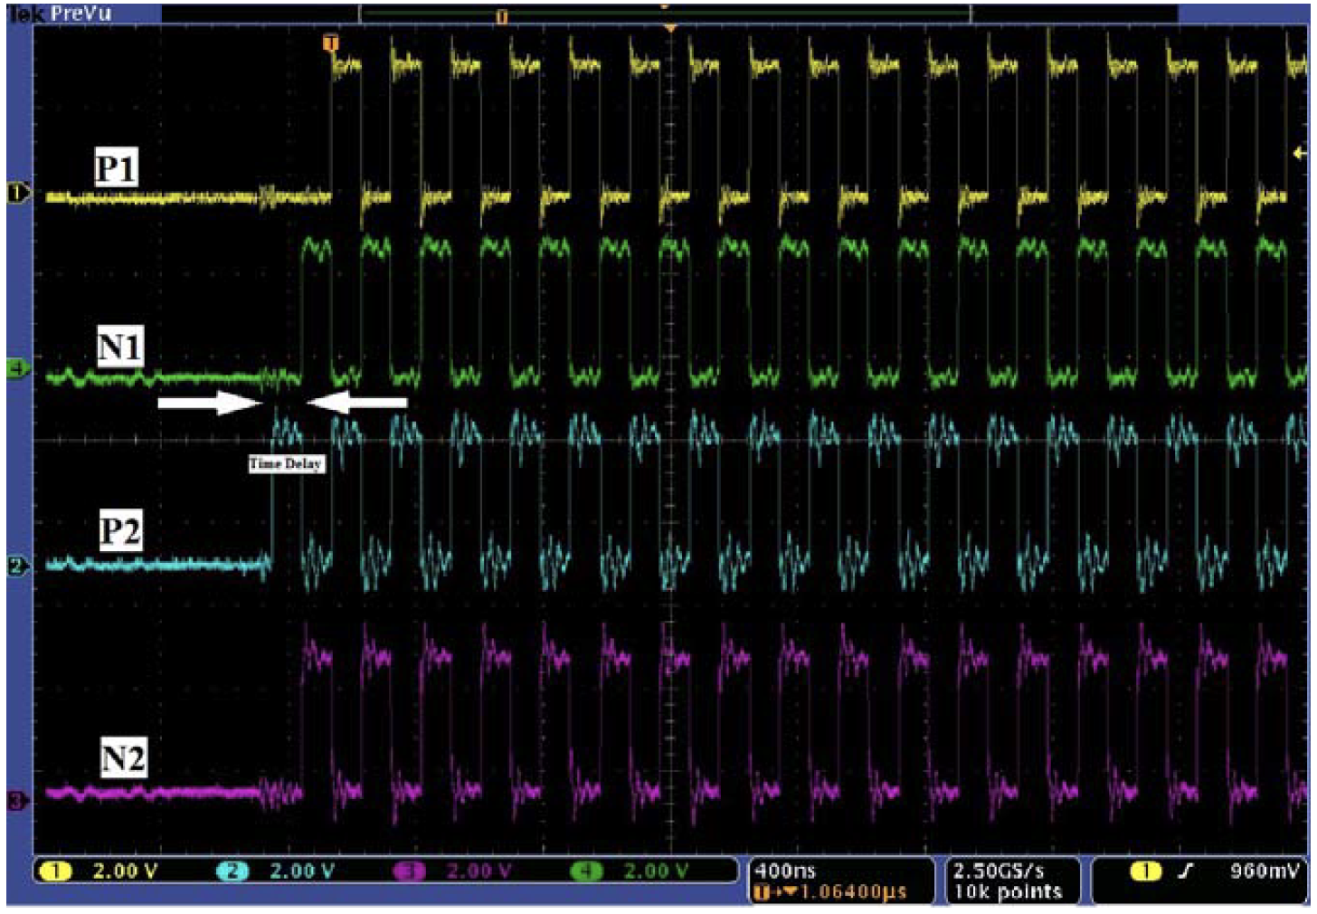
Digital Tx Beamformer
37/48

Slide 38
HV Pulser
Acts as a Digital to Analog Converter (DAC)
Ultrasound Sensors are excited at high voltage (100Vpp) and high frequencies (2-20 MHz).
Also acts as switch to receive ultrasound reflected signal from tissue.
It does so by making use of two logic inputs
If both are 1 the pulser acts as a receiver
If both are 0 the output is 0
If both are different logic then it acts as a DAC
38/48

Slide 39
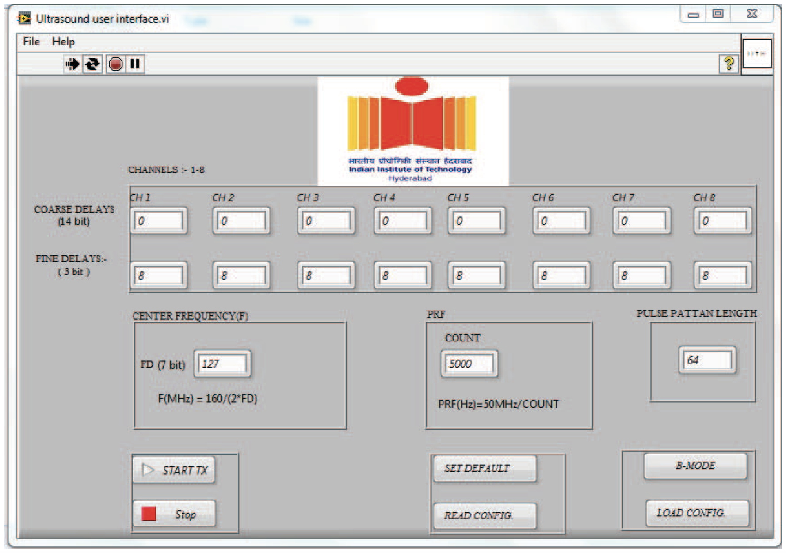
User Interface
39/48

Slide 40
User Interface
Developed with National Instruments LabVIEW 2012
Spartan-3E starter kit is connected to Personal Computer (PC) through USB and interfaced LabVIEW project
This can provide extensive user control of transmission parameters during pulse-echo experiments
Multiple transmission parameters for each of 8 channels can be modified, including coarse time delay and fine time delay
40/48

Slide 41
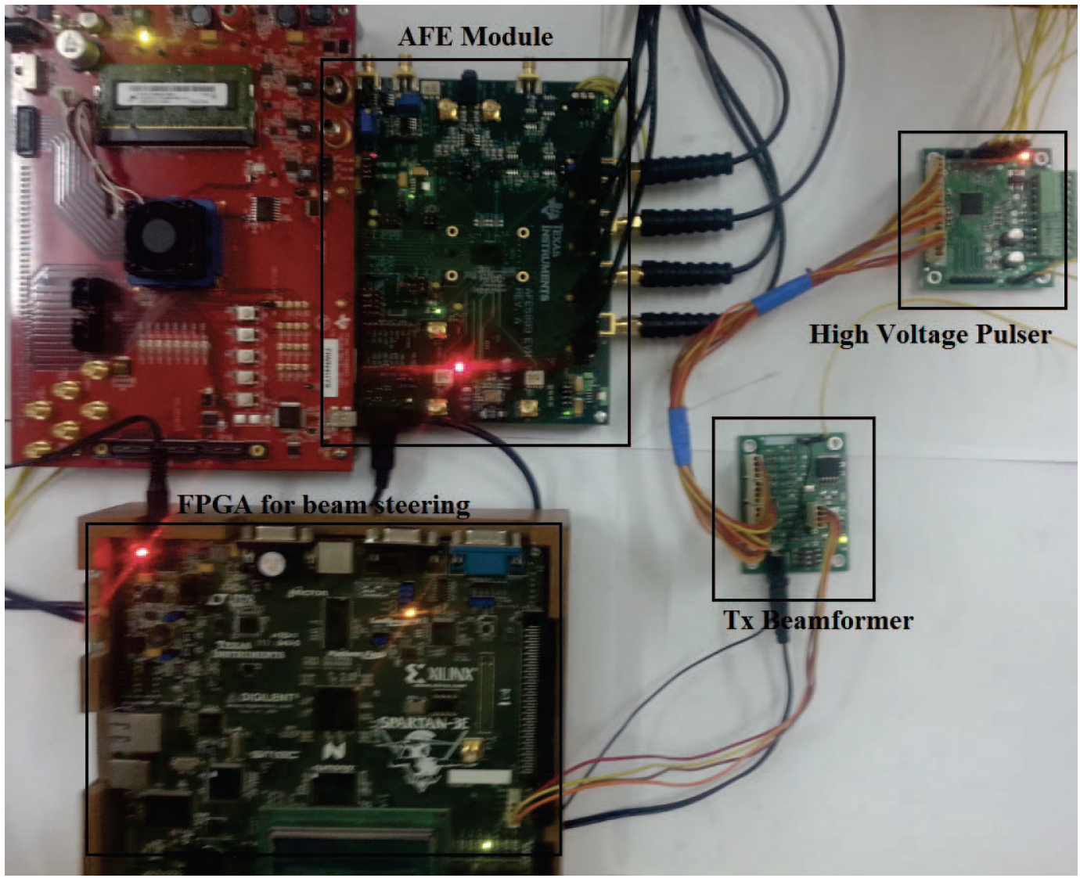
Final Setup
41/48

Slide 42
Final Setup
Two in-house made boards for Tx beamformer and HV Pulser
Spartan 3E starter board
AFE 5809 EVM
42/48

Slide 43
Experiment
An experiment is conducted using our design to transmit ultrasound burst in to the gelatin phantom to acquire ultrasound images
Pre-calculated delay profile to steer and focus the acoustic beam are loaded into GUI
The delay profile to the 8-channels are dynamically updated between each consecutive transmission to obtain different steering angles
43/48

Slide 44
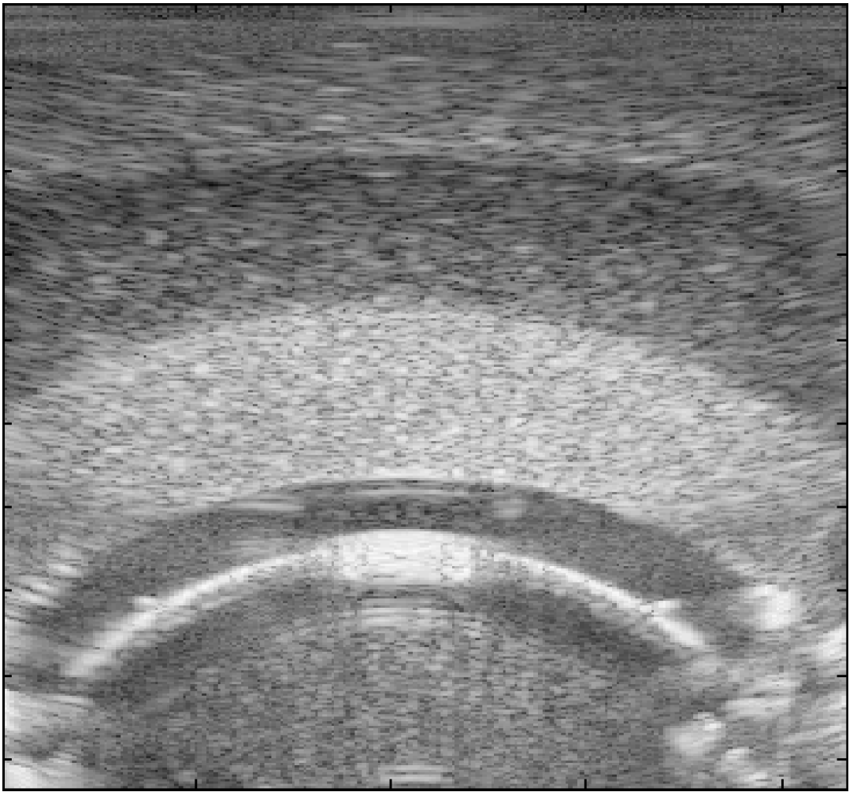
Result
44/48

Slide 45
Features
8 independent transmit channels to drive eight transducer elements; can be extended to more number of channels
High speed serial interface for the 8-channels with data rate up to 80Mbps
Flexible user interface to select and modify transmission parameters
Minimum time delay of beamformer - 0.78 ns
The HV pulser has 8-integrated transmit receive(T/R) switches
Flexibility to examine the output signals at each stage of the system
45/48

Slide 46
PROS:
Low complex hardware and inexpensive ( $166) compared to existing transmit modules for research purposes
Provides researchers with freedom to control the transmit parameters
CONS:
They are calculating the delay profiles and storing them in the FPGA beforehand. While this might work for this scenario. A real-time method of generating such delay profiles should be developed.
Very few implementation detail are given in the paper
46/48

Slide 47
Conclusion and Future Scope
A programmable open platform for real-time UBM based on a high-speed FPGA was developed and evaluated.
It was implemented in a compact and cost-effective PCB scheme.
This open platform demonstrated high image quality with a good spatial resolution for preclinical small animal imaging.
Future Scope would Include : a) using a USB Interface instead of the 64 bit PCI Bus. b) System can be upgraded to connect Monitor and Hard disk directly for real time imaging and image data saving without the use of CPU. c) system can also be expanded to suit HF array based transducers.
Developing same kind of system for other transmit techniques like the Continuous Wave Doppler (CWD)
47/48

Slide 48
48/48

